Slide 1
Cloud Computing
Cloud
Computing
The future of computing.

Slide 2
Team Members
Shishir Pun
Niraj Mehta
Nischal Khati
Rabindra Rawal
Sarbocha Panday

Slide 3
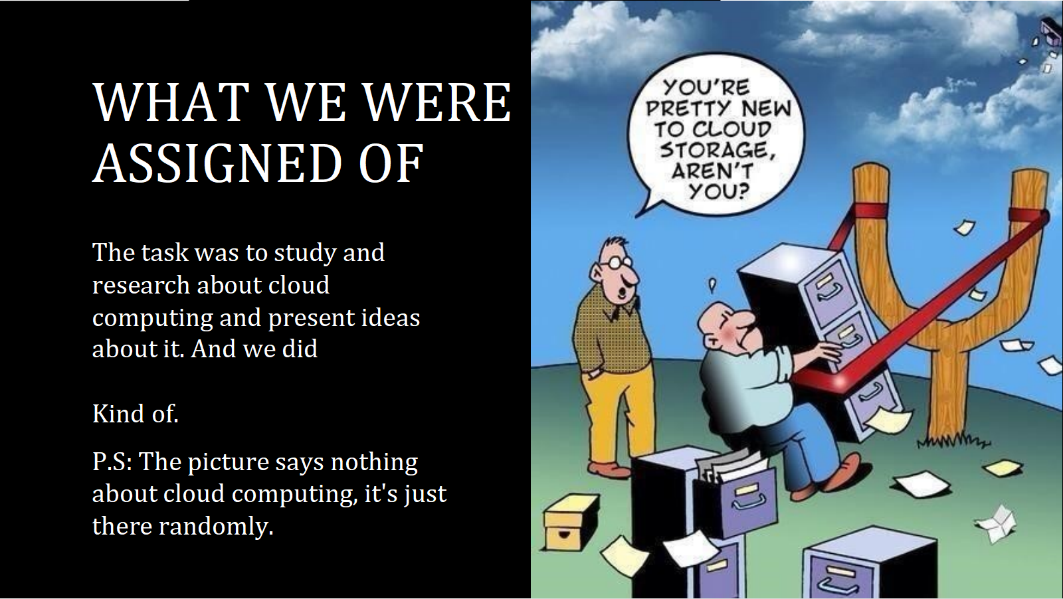

WHAT WE WERE ASSIGNED OF

Slide 4
Table of contents
01
02
03
04
Introduction
& concept
Types of cloud
Comuting
Types of cloud Services
Benefits and challenges.
What is cloud computing?
Based on the services a business needs.
Popular cloud computing models.
Manage cloud risks for great rewards!

Slide 5
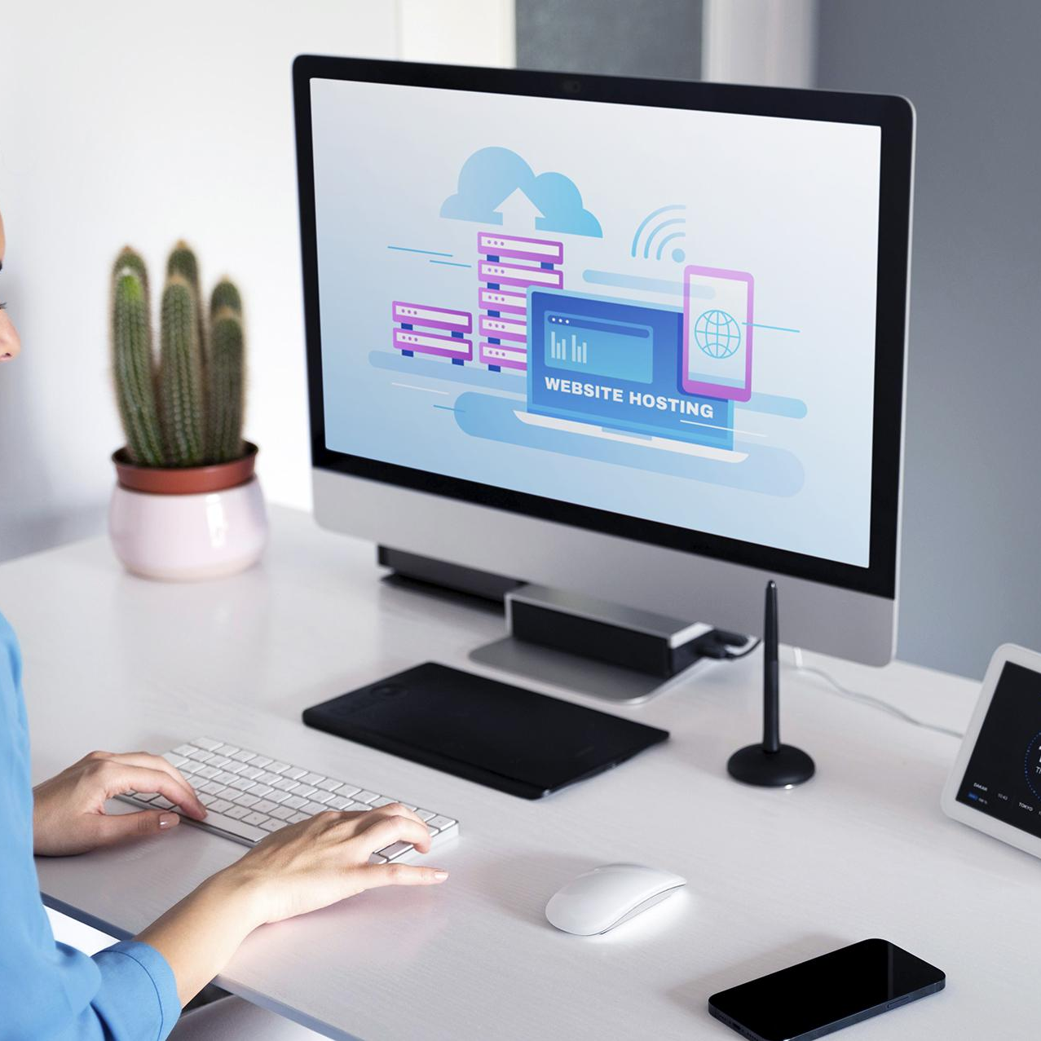
What is cloud computing?
Cloud computing refers to the delivery of computing services such as servers, storage, databases, software, and more over the internet, rather than from a local server or personal computer.
Cloud computing allows users to access these services on-demand, from anywhere in the world with an internet connection.​
Computing

Slide 6
What are it’s types.
1. Private Clouds
Provides advanced data security
Makes disaster recovery and system management processes more efficient.
2. Public Clouds
It is cost-efficient for small businesses as there is no need to set up IT infrastructure
It offers easy maintenance and scalability

Slide 7
3. Hybrid Clouds
Hybrid clouds enable flexibility and enhanced data security.
Reduces the cost of setting up IT infrastructure.
4. Multi-Clouds
It allows businesses to avail of a variety of cloud services from multiple vendors
It reduces the risk of lock-in with a single vendor, thus enabling smooth operational flow.

Slide 8
Types of cloud services
Software-as-a-Service (SaaS): This cloud-based model provides on-demand software or applications to users through the Internet.
Platform-as-a-Service (PaaS): It provides IT infrastructure like hardware and software to the users for easy development, running, and management of applications.
Infrastructure-as-a-Service (IaaS): It provides hardware like computer storage and networks virtually to users.

Slide 9
Benefits
Cloud
1: Cost Savings
Cloud computing can help businesses save money by reducing capital expenditures on hardware and infrastructure.
Instead of buying and maintaining expensive hardware, businesses can use cloud services on a pay-per-use basis, and scale up or down as needed.

Slide 10
2. Scalability
Cloud computing can help businesses save money by reducing capital expenditures on hardware and infrastructure.
Instead of buying and maintaining expensive hardware, businesses can use cloud services on a pay-per-use basis, and scale up or down as needed.
3. Flexibility
Cloud computing allows businesses to access their applications and data from anywhere with an internet connection.
This provides greater flexibility and mobility for employees, as they can work from anywhere, on any device.

Slide 11
4.Security
Cloud computing providers typically offer advanced security features such as data encryption, firewalls, and access controls, making it more secure than traditional on-premise computing.
This can help businesses protect their sensitive data and prevent cyber-attacks.
5. Reliablility
It provides data backup, disaster recovery and business contunity in less cost.
Companies can store their data securely in the cloud and access it from anywhere in case of a disaster.

Slide 12
Challenges/ Disadvanages
Be aware
1. Downtime
Businesses receive cloud computing services only through the Internet.
When there is an internet outage or weak connectivity, services get interrupted and this increases downtime.
2. Limited control
Since the cloud service providers own, manage and monitor the entire cloud infrastructure, most companies have minimal control over their data.

Slide 13
3. Vendor Lock-in
Vendor lock-in refers to a situation where companies using cloud computing services of a particular vendor are unable to switch to a different vendor. This usually happens because of high switching costs, large amounts of data which is difficult to migrate, and several other complexities. In case of vendor lock-in, companies are forced to receive services from a particular vendor.
4.Dependency on Internet Connection
Cloud computing is entirely dependent on the internet connection.
If the internet connection is slow or not available, then the user cannot access the cloud services, making it an unreliable option.

Slide 14

To hit our mind

Slide 15
Thank You
Here’s nothing
I would like to thank my teacher, my mentor who have helped me
throughout this, who have taught me the basics, guided me through
every little things. I would like to show gratitude towards Mr. Sundar
Pichai (we kinda look alike) that's what my mom says and Mr. AST sir.

